Slide 1
Ecommerce Platform for Reusable items
Thrift Green
Info 6210 - Prof. Naveen
Team member:
Giang Vu
Amogha Shettar
Amoolya Shettar

Slide 2

Problems/Ideas
Household Items can be reused, but currently most of the market for 2nd hand items is local thrift store.
Other platforms are too general (Amazon) or lack security/payment options (Craigslist)
=> Online 2nd-hand, reusable item ecommerce platform allow users login, online transaction
THRIFT GREEN

Slide 3
Overview
Have 4 type of security level/users: admin, seller, shipper, customer
13 different entities + 1 bridge table.
Users register/login with email/username/password
Platform allow use of search for item based on price/ categories
Can keep track of order details with shipment and shipper tables.

Slide 4
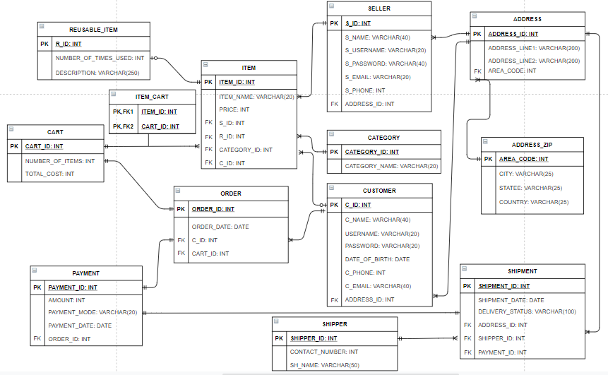
ER Diagram

Slide 5
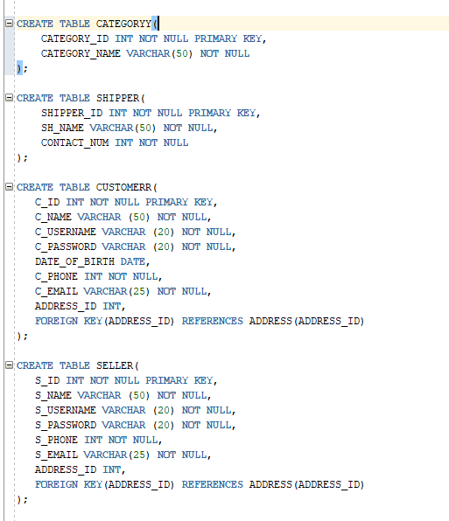
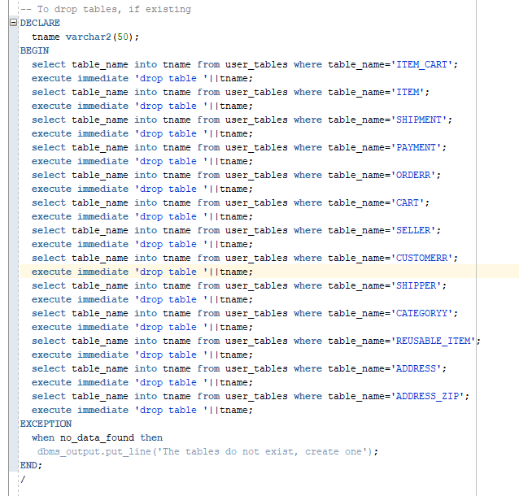
Sample DDL
Check if table exist + Tables creation

Slide 6
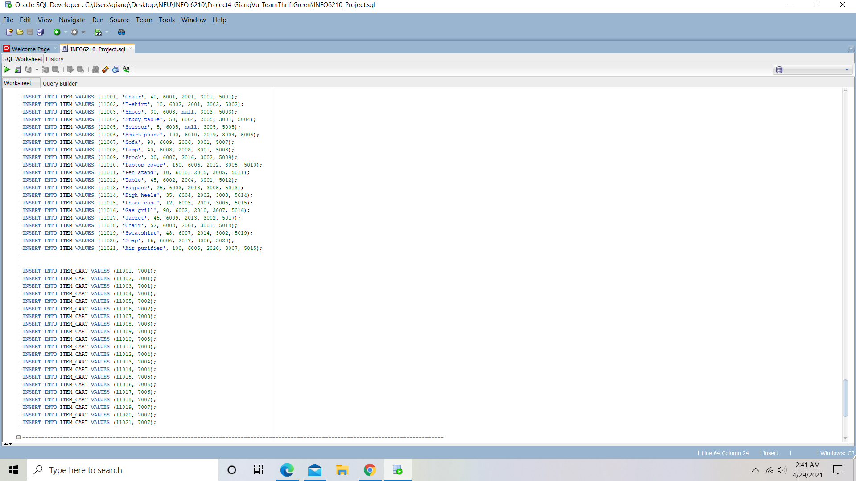
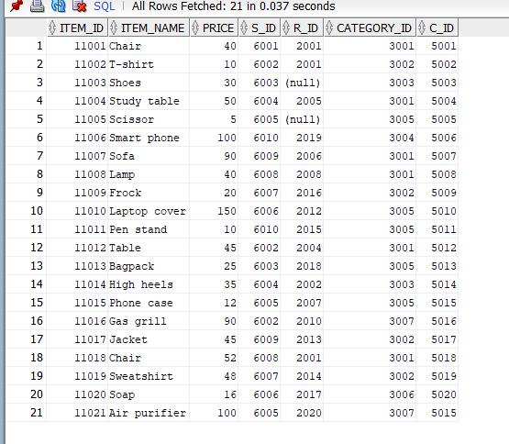
Sample DDL

Slide 7
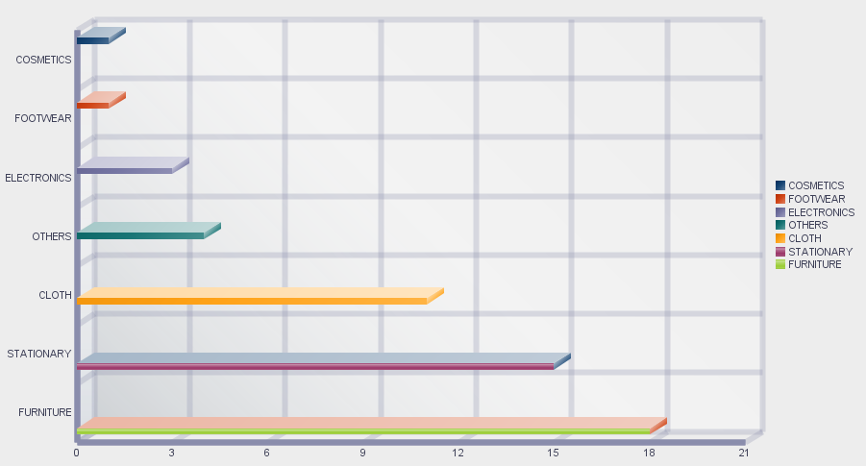
Reports

Slide 8
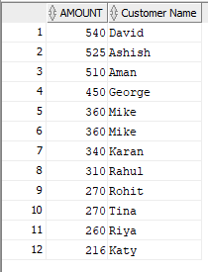
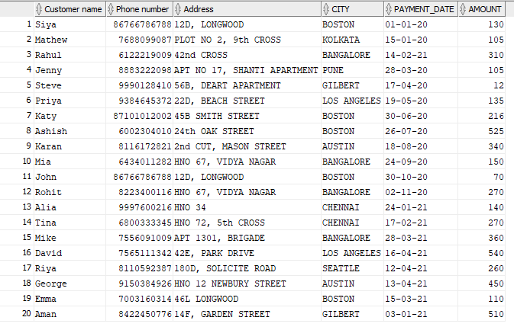

Slide 9
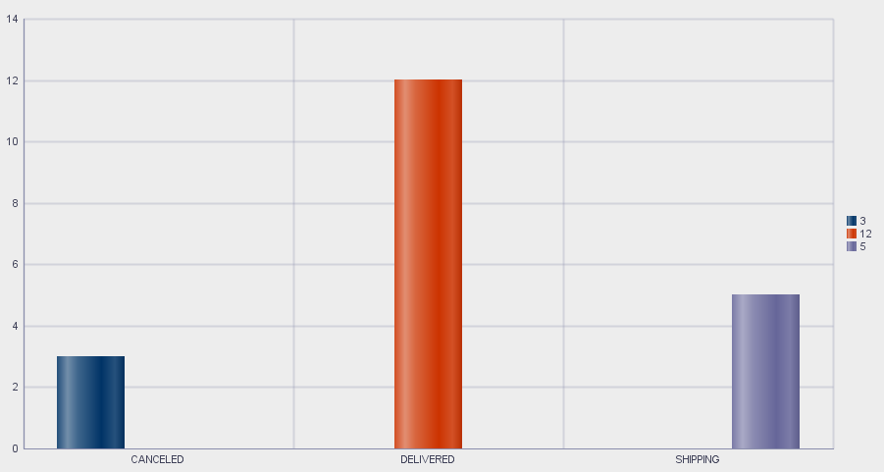
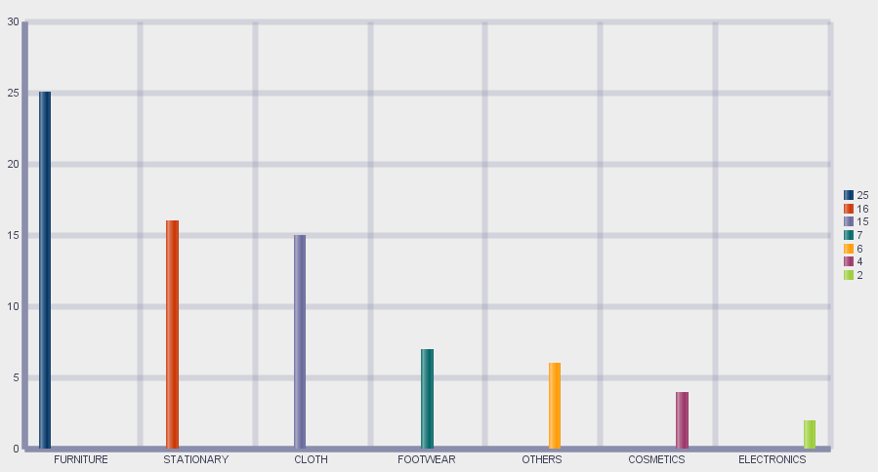

Slide 10

Thank you!

